Slide 1

RoboTour
A robot that improves your experience in museums
Notes:
Finn
This is RoboTour. RoboTour is a multi-purpose assistive robot tailored to museum visitors. Our mission is to provide a dynamic cultural experience for museum visitors through 2 unique value propositions:
As outlined in our project plan, we have achieved 4 key milestones for demo 1: Basic Robot Building, App-to-Robot Communication, Basic UI Designs, and Basic Collision Avoidance.
For each of these milestone, our members will also talk about what’s next steps.

Slide 2
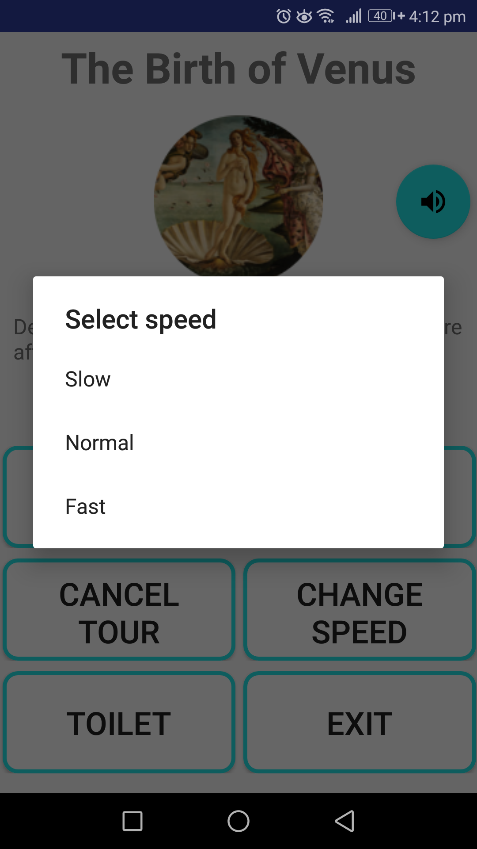
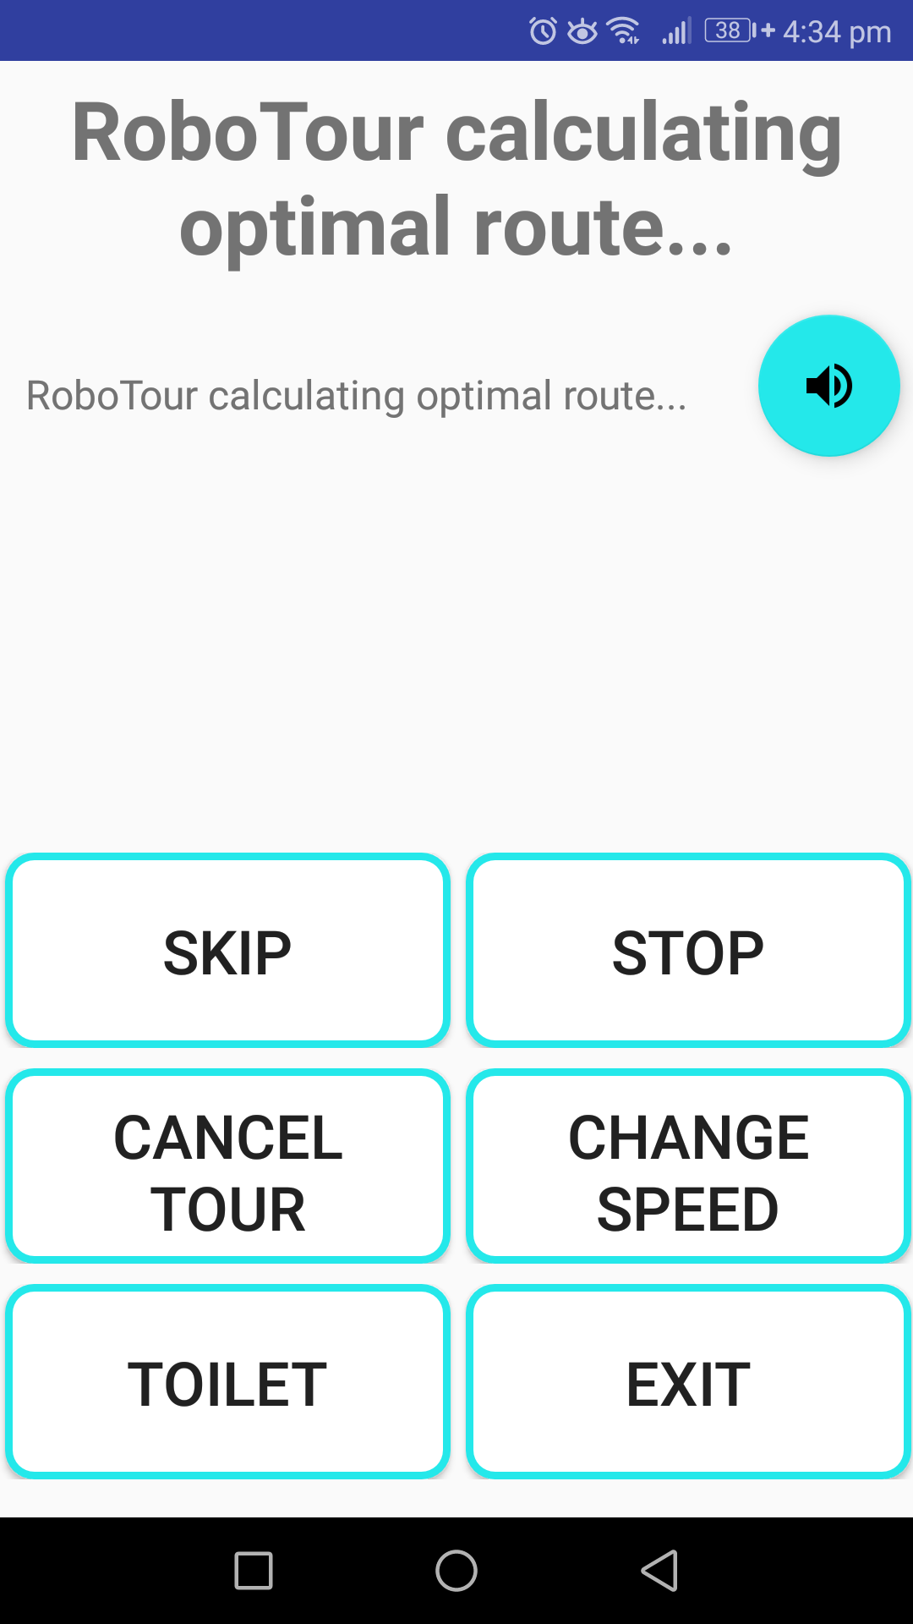
Speed Adjustment / Variable Speed
Improved PID values for line following
Limited motor speed range
Very smooth line following at slow mode
Satisfactory performance at higher speeds

Slide 3
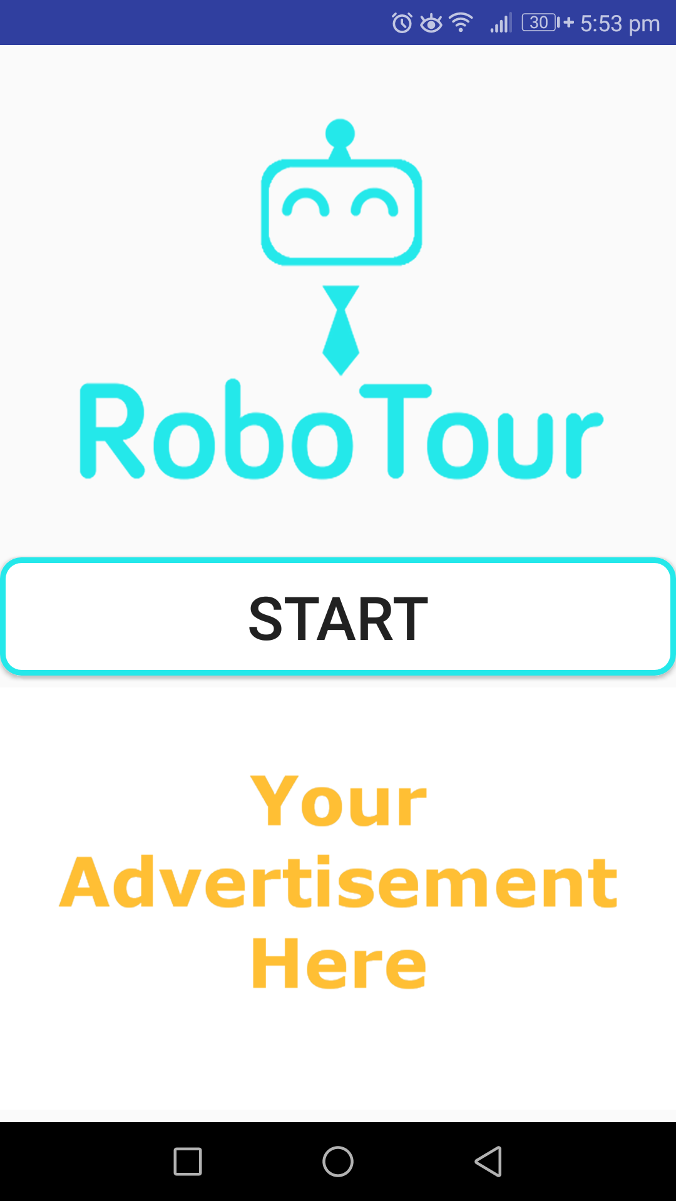
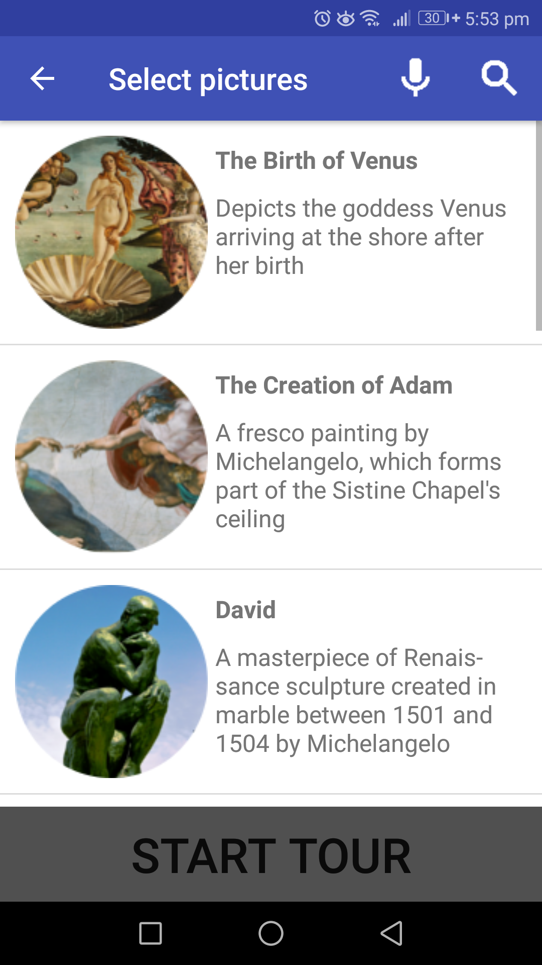
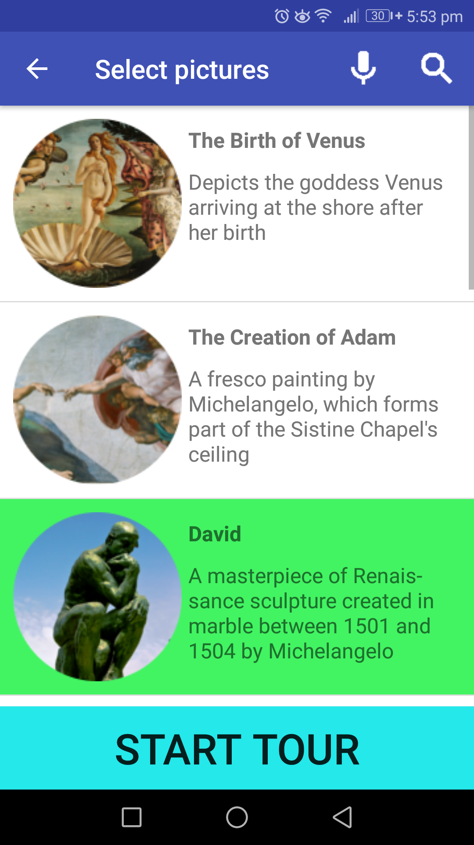
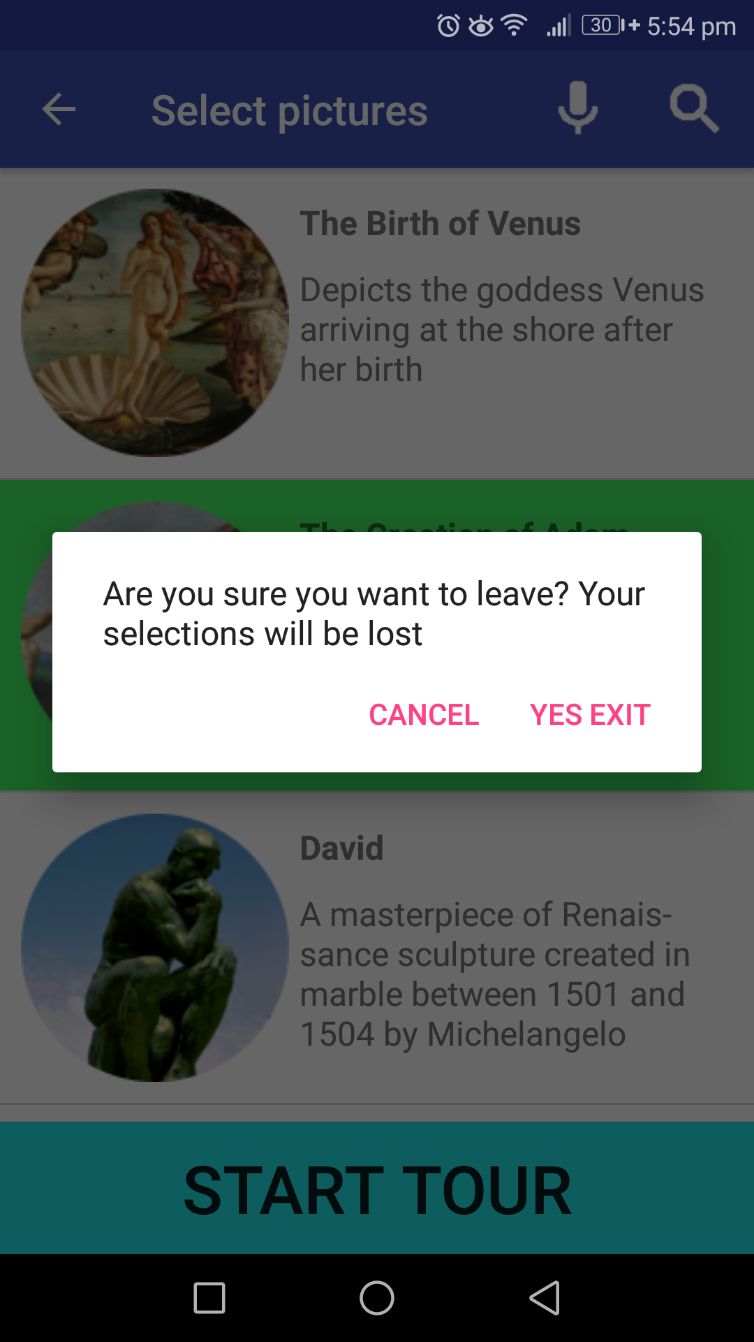
Improved User Interface
Home Screen With
Advertisements
Pictures Activity with No Selections
Pictures Activity with at least 1 Selection
Exiting Activity With Selections Made
Notes:
User Improvements
ADDED ADVERTS ON THE SCREEN FOR INVESTOR NEEDS
ADDED BACK BUTTON OVERRIDE SMARTLY
Question for Mahbub: Did we add extra commands to the NavActivity to make the robot feel more intelligent?

Slide 4
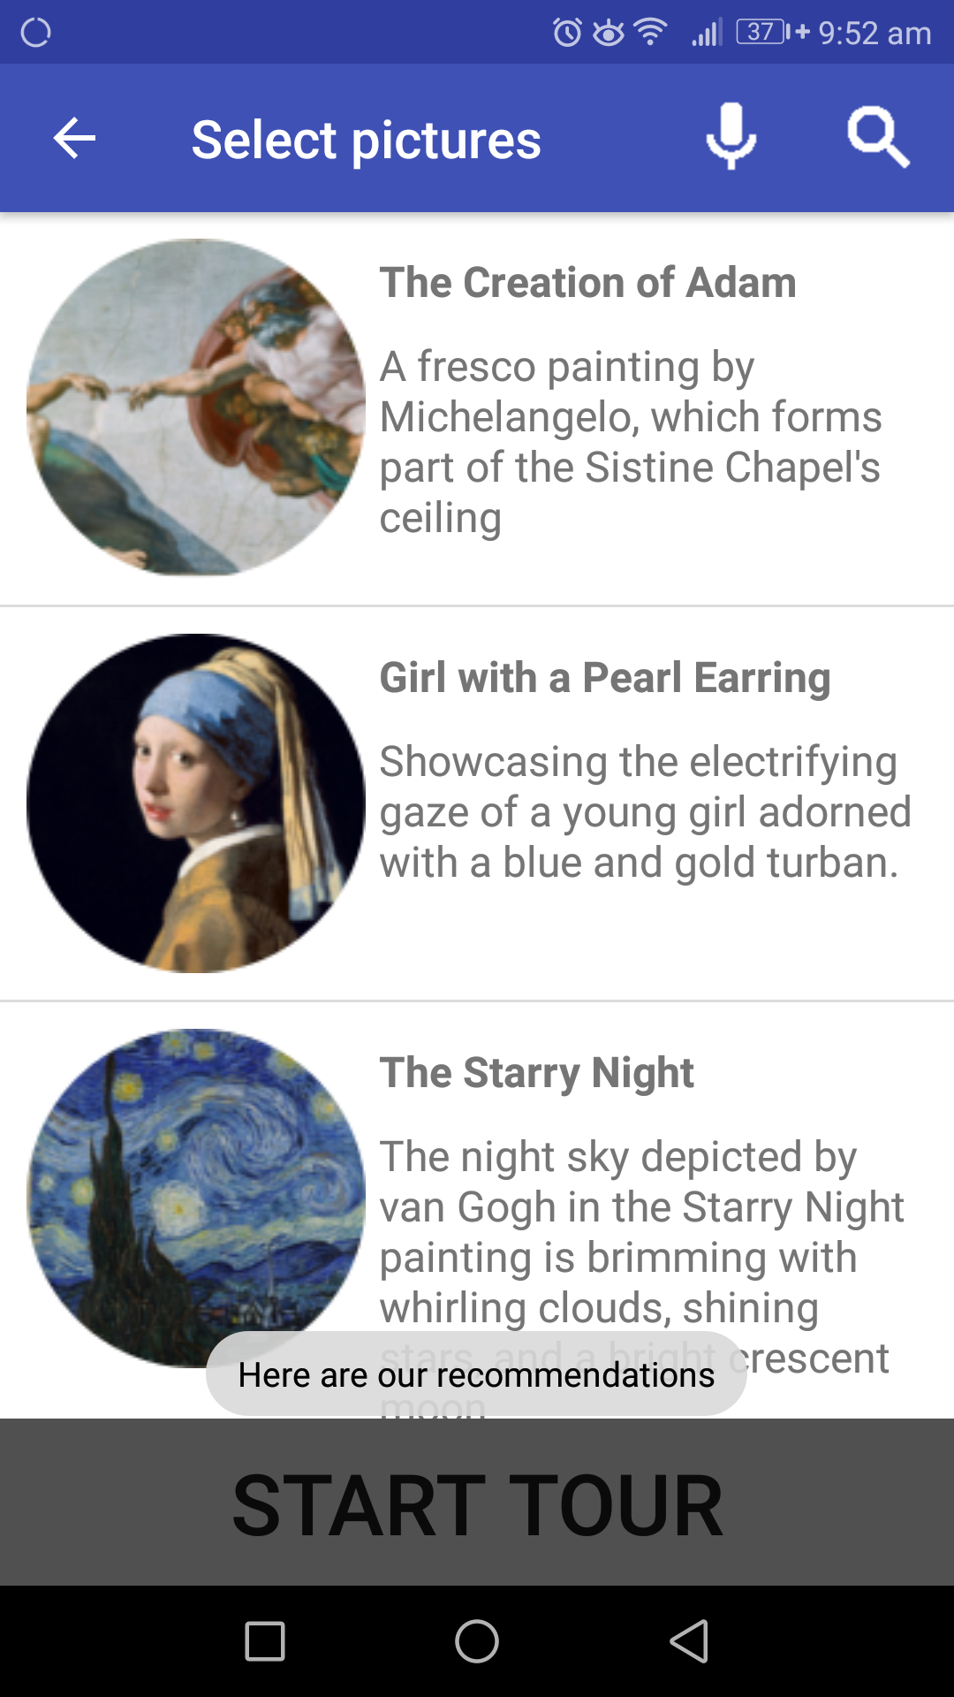

Improved User Interface - Speech Commands
Acceptable queries that return a subset of the paintings:
“Best” / “Recommend”
“Popular”
“New”
The App replies using Text-to-Speech
Notes:
A big part of improving the UX from the last demo was making the speech commands feel more intelligent. To do this we added 2 things:
The app now has some acceptable query words. If it hears any of the following words here in a query it will return a subset of the paintings
The app also replies like most personal assistants do to let the user know what it heard.

Slide 5
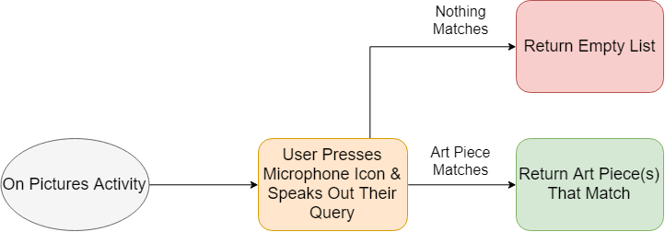
Improved UI - Previous Speech FlowChart
Notes:
So here you can see how the speech processing worked previously.
As you can see… *go through it
While this worked perfectly well it made the app feel very simple and in our user testing we found that when we told people you could search through the list using voice commands some users would say “What are the best paintings”, which would just return an empty list.
So we changed it to *next slide

Slide 6
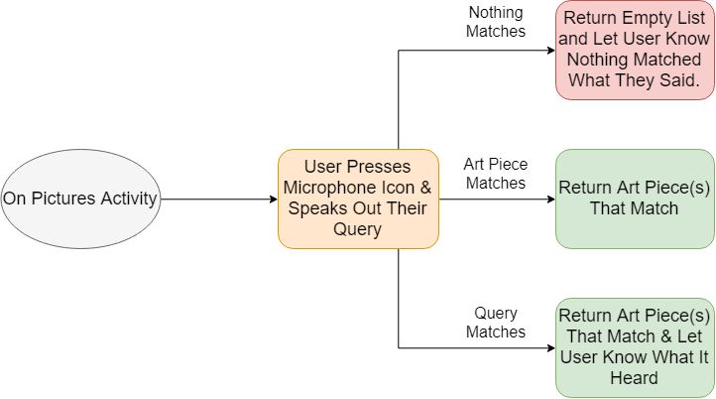
Improved UI - Improved Speech Flowchart
Notes:
So as you can see, these 3 steps are the same *point to middle 3, however now the app listens for the query words as well as the art piece names and if nothing matches, the app speaks letting the user know that what they said yielded no results.
And best of all, the query and art piece matching have been integrated to both work in the same sentence. So if the user says “Where is the Mona Lisa & What paintings are popular” the app is able to handle that just fine.

Slide 7
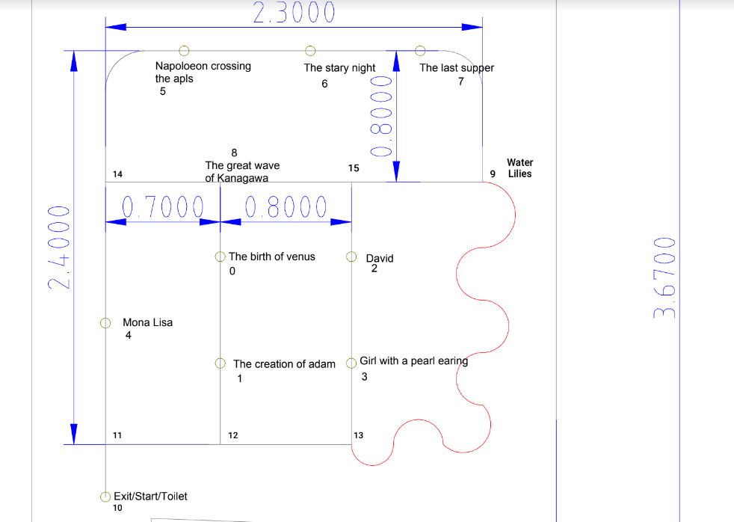
Map For Complex Path Planning
Notes:
Alice
This is the temporary map of our museum. We have programed this map into the robot as three part:
One is the distance between each neighbour - this is used for calculating the walking distance between two paintings
Second is the orientation of the neighbour points - if the robot knows it location and orientation, and if it want to go to its neighbour it can align the orientation according to the map
Last one is the orientation of the painting - the pointer can use this map to point to the correct painting.
Finn will talk about the algorithm in detail.

Slide 8
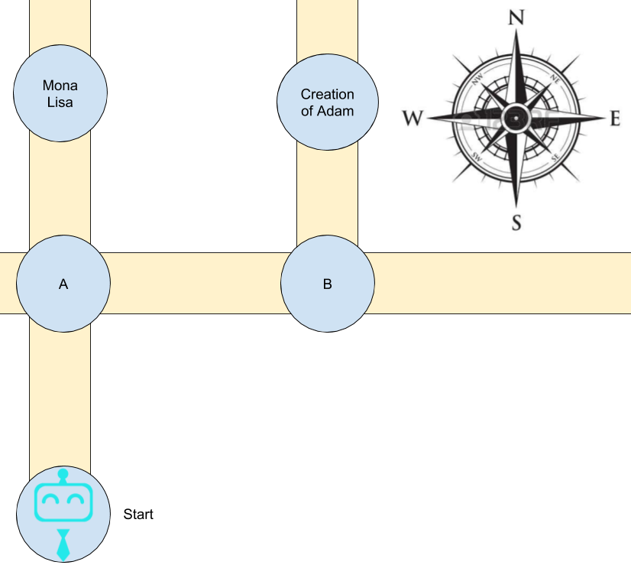
Complex Path Planning
We know 3 facts:
Robot’s orientation and position (point)
The neighbouring points and its orientation
The path of the closest painting in the stack using Dijkstra algorithm (cost function = distance)
Robot’s position and orientation = “Start” | North
Stack = {Mona Lisa, The Creation of Adam}
Closest painting = Mona Lisa
The path outputted by Dijkstra= Start -> A -> Mona Lisa
“A” is North of “Start” and “Mona Lisa” is North of “A”
RoboTour aligns its orientation to the next point in the path and move forward until it arrives the point.
Notes:
Finn

Slide 9
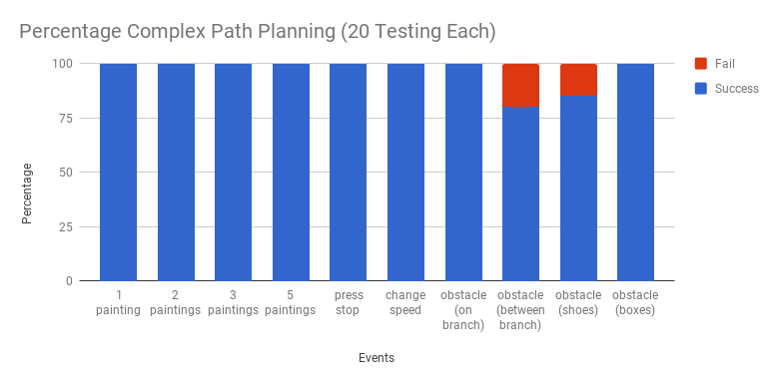
Complex Path Planning Testing
Notes:
Alice
In the last demo we had a problem that our robot cannot detect the sharp edges, so we improved this using the method you suggested. It succeeds with the boxes now but it still has some problems with the gap between the shoes. And we mentioned two edge cases as well. We solved these by adding black lines in front of the wall and at the corner. When the robot detects the black lines, it will turn 180 degrees and go the other way round. And if both ways are block, then the robot will stop and ask someone to remove the obstacle.
And for the complex path planning, there is still some problem. We have tested 8 different events, 20 times each. And as you can see in the graph, it succeeds almost every time, but it sometimes fails when there is obstacle on the line. We found that happened because we are using the white tapes as the marker, so after the robot goes around the obstacle and wants to find the lines, it may regard the marker as the line. We don’t have enough colour tapes now, but we believe this can be solved by changing the marker’s colour.
Next Michal will talk about the Custom Line Sensor

Slide 10
Custom line sensor
Implemented improvements:
Autocalibration algorithm
Higher sensitivity and contrast
Sensor adjusted for height rejection
Sensor v1.1 in production
Known issues:
Relatively low polling rate
Intermittent wrong readings

Slide 11
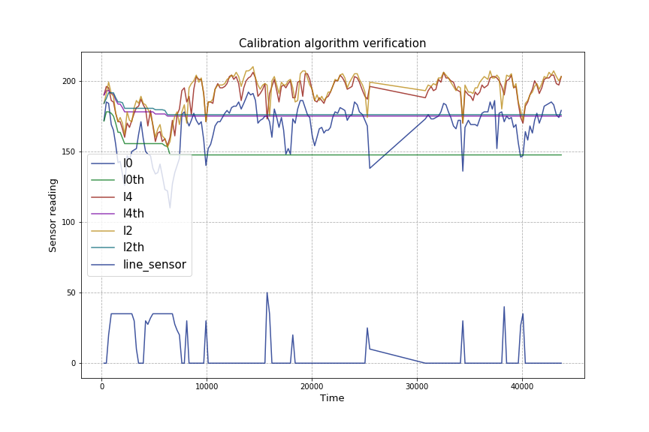
Custom line sensor - autocalibration

Slide 12
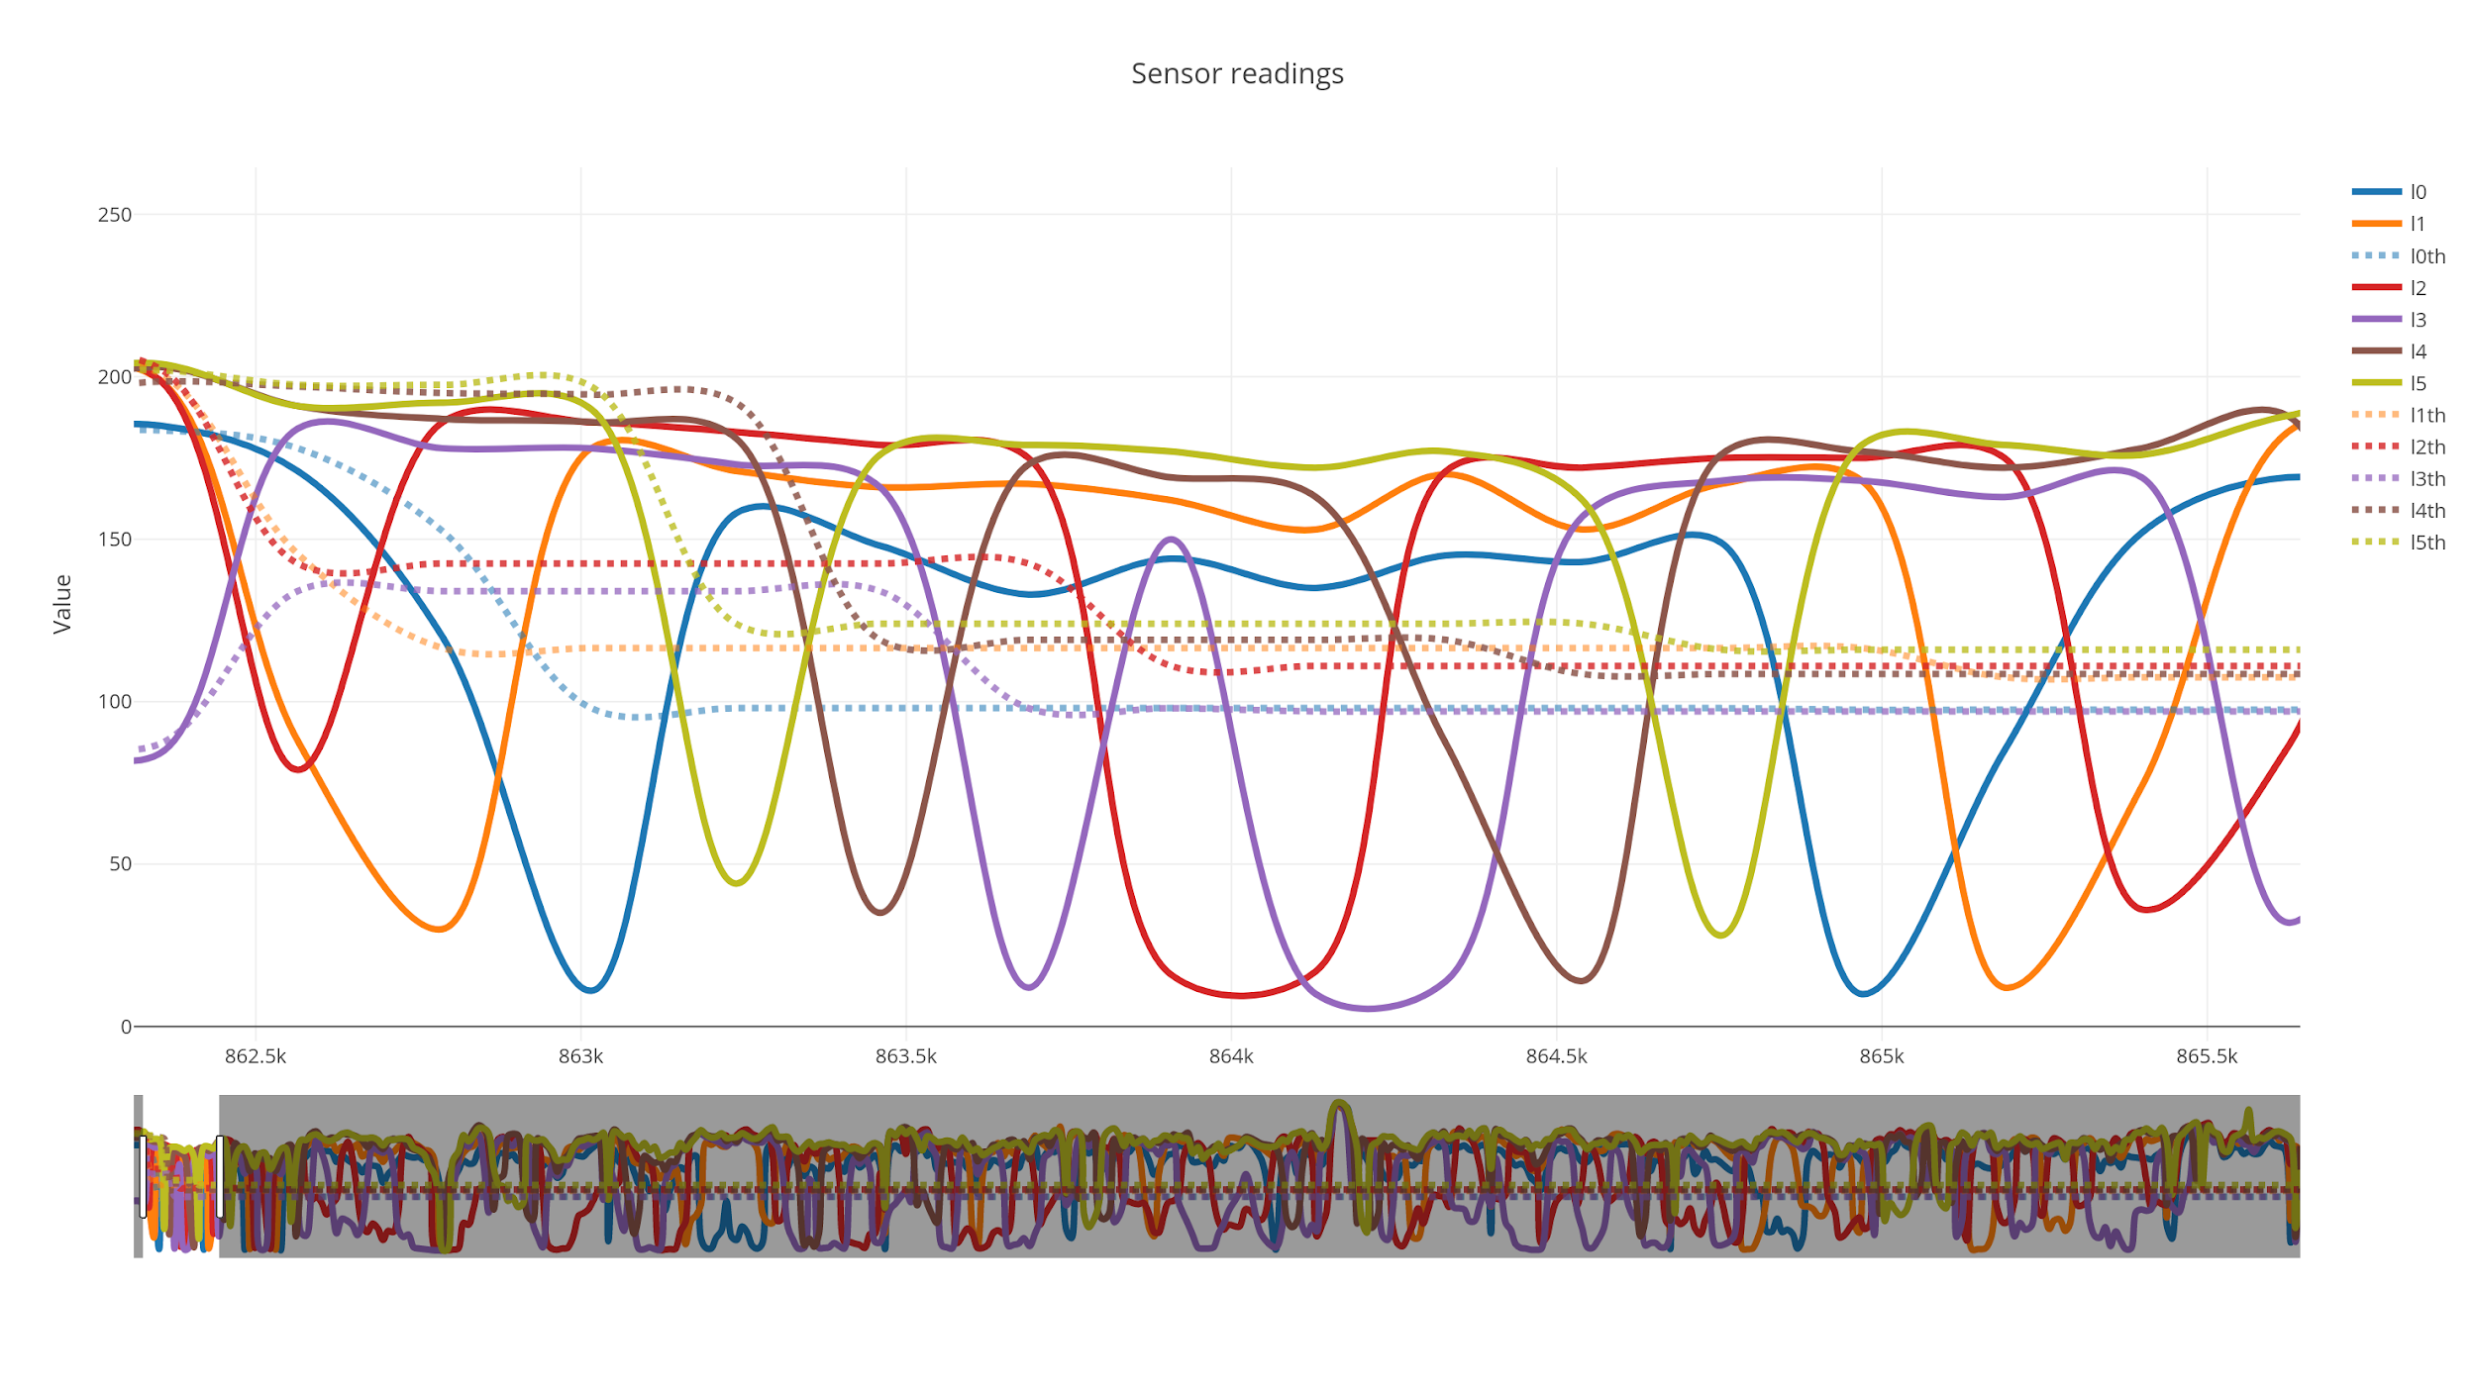
Custom sensor - autocalibration improved

Slide 13
Live Demonstration
Notes:
David

Slide 14
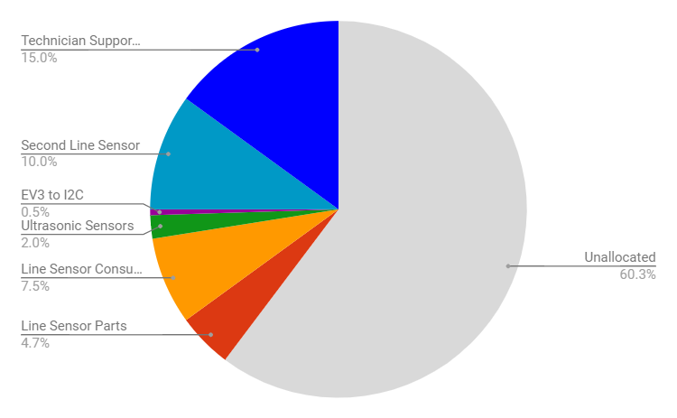
Resources/Member
Time Spent: 132 Remain: 68 (hrs/member)
Guest lectures: 3 (of 6)
Demonstrations 1 (of 4)
Group meetings: 11 (of 25)
Planning and Admin 16 (of 40)
Debugging & Testing: 10 (of 30)
Code Reviews: 2 (of 10)
Robot construction: 5 (of 10)
Code development 20 (of 75)
Fig 13: Budget pie chart
Notes:
Michal
Main:
Conclusion: We are on schedule to completing tasks because it took us 50 hours/member of work each to get to this point

Slide 15
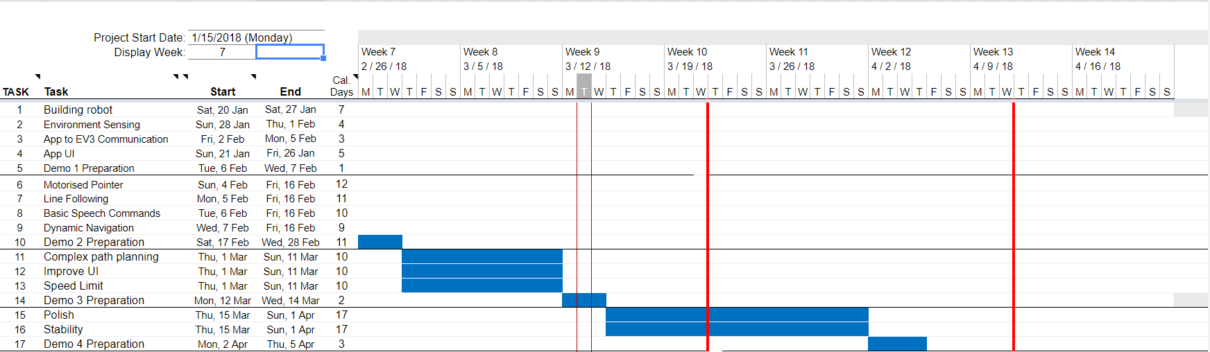
Plans Going Forward - Revised Gantt Chart
Fig 11: Gantt chart
Notes:
- Mariyana still ill and not in Edinburgh - We expected her to be back, but due to medical complications she hasn’t come back yet- hence we need to reshuffle
- We also reshuffled further according to each team members strengths
- We have done this to ensure that we we optimally use our time to produce the best quality work in an efficient manour.
Let’s discuss:
Question for Mahbub: We didn’t really mention the Mariyana stuff last time. I think again we should just briefly gloss over it (update Carson with 1 sentence).
Maybe say that in our project plan we kept these 2 things quite vague and then go into exactly what we mean with polish and stability, because we didn’t know what would need polish / stability improvements. Talk about how initially we we thought speech would be much harder, and object avoidance easier, and so while the gannt chart hasn’t changed what has changed is what we’re polishing and stabilising. (work on software side of custom line sensor to make it as smooth as possible, keep working on obstacle avoidance, improve app performance and multi phone support and extra phone commands (skip, toilet etc.)) - even though I realise that more has to do with the next slide.

Slide 16
Next Steps
3.1.4 Final Client Demo - 05/04/2018
Technical Achievement | Evidence
Stability | The robot performs its tasks more reliably and consistently than in previous demonstrations.
Polish | Features from previous demos that needed polishing or enhancement are improved. Overall user experience is enhanced due to a better robot performance and better speech recognition.
Fig 12: Milestones for next client demo
Notes:
Here we have what we plan to have completed for Demo 2.
Address 4 points
The only difference with this is like Michal said we are building a custom line sensor for this demo.

Slide 17
Thank You
We would like to welcome any questions or suggestions that you may have.
Notes:
We would all like to thank you for listening to our demonstration. We would like to invite you to have a look at our current system and would welcome any questions or suggestions you may have.

